Slide 1
EAD POST MID PROJECT
BCSF20M028
AYESHA ARSHAD

Slide 2
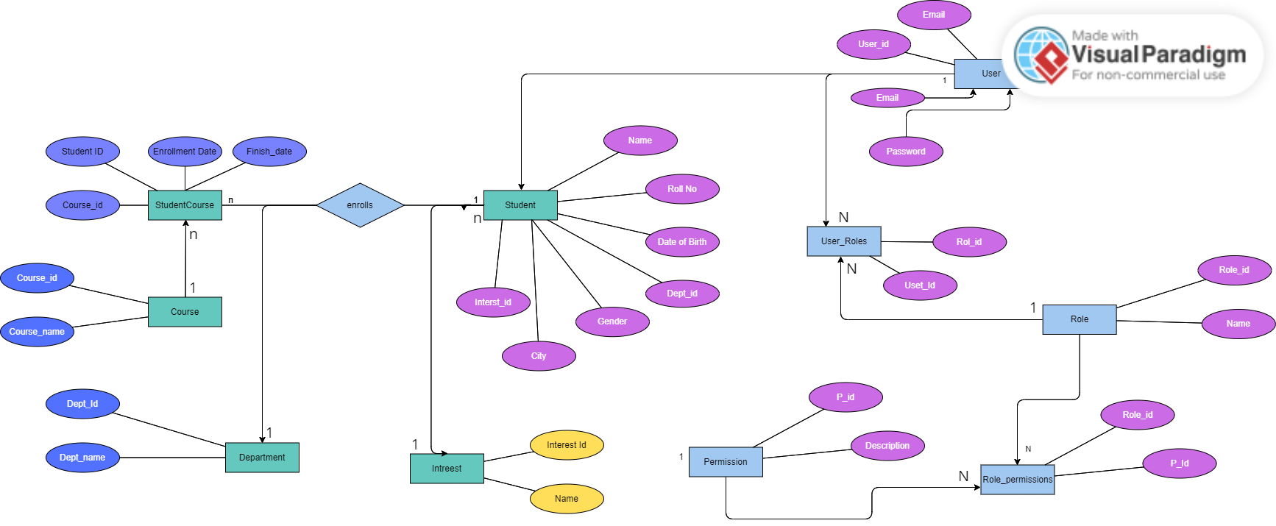
ERD DIAGRAM

Slide 3
Technologies
FRONTEND
For frontend I used React-js because it is very popular and easy to use and with the help of this a maintainable frontend can be developed.
BACKEND
For Backend I used a popular framework Django and I have Rest APIs to fetch and post data throughout the application
Colors:
I used Combination of Teal and Gray color

Slide 4
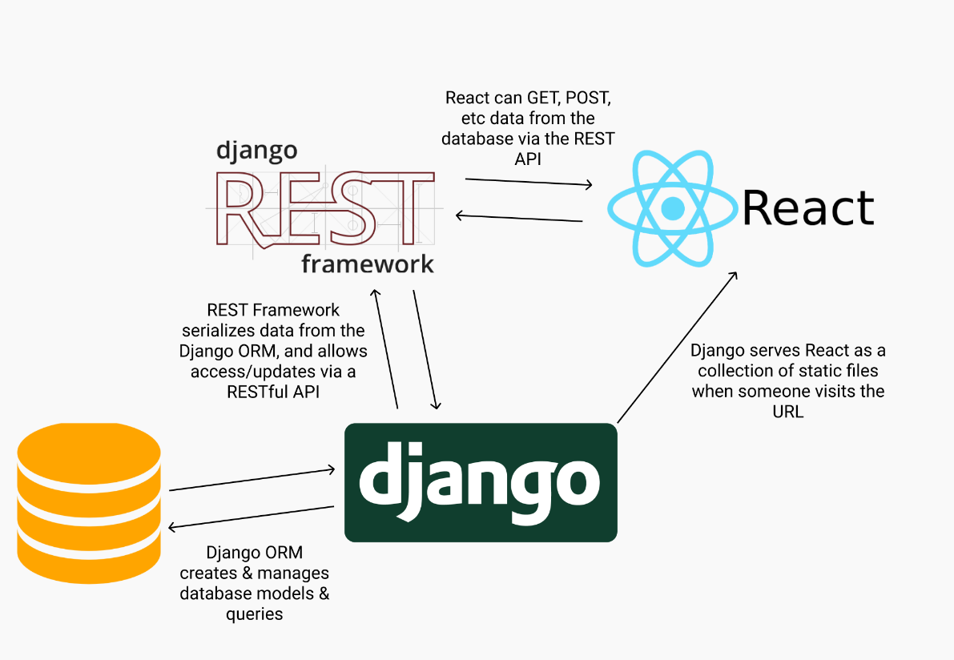
Diagram

Slide 5
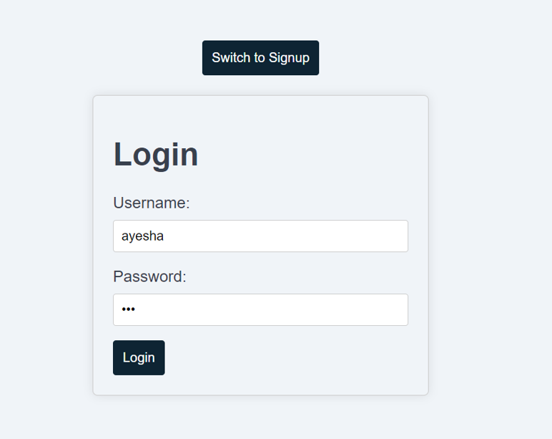
Application Flow
Log in Page:
First user needs to login in
order to access the application

Slide 6
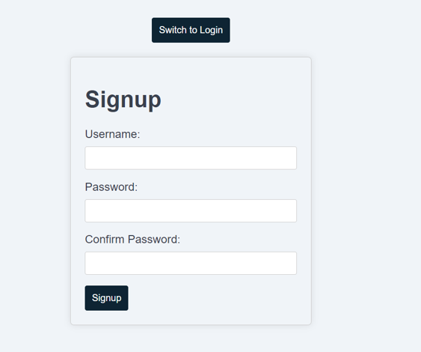
Application Flow
Sign up Page:
First user needs to sign up
of login in order to access the
application

Slide 7
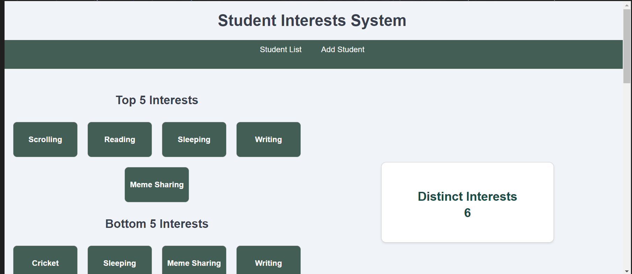
Application Flow
Then Dashboard will be appear

Slide 8
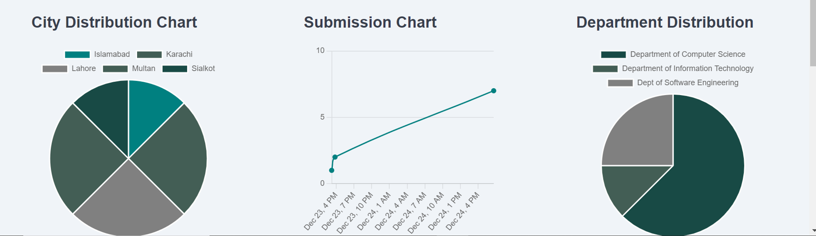
City,Submission and Department Charts

Slide 9
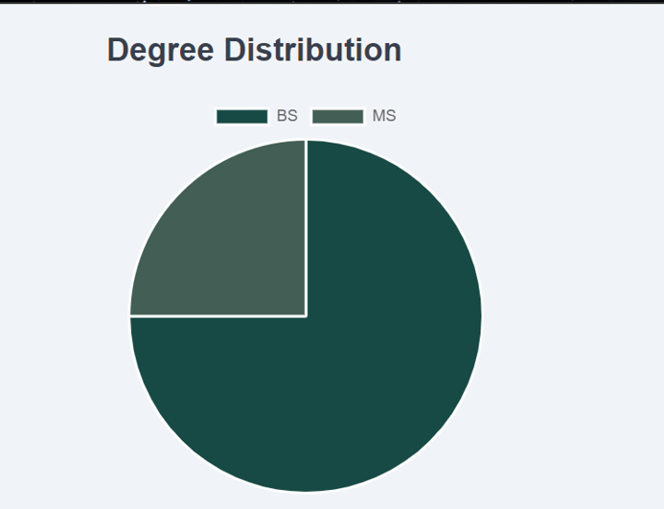
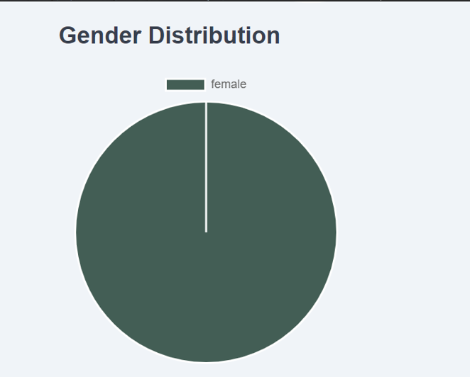
Degree Distribution Gender Distribution

Slide 10
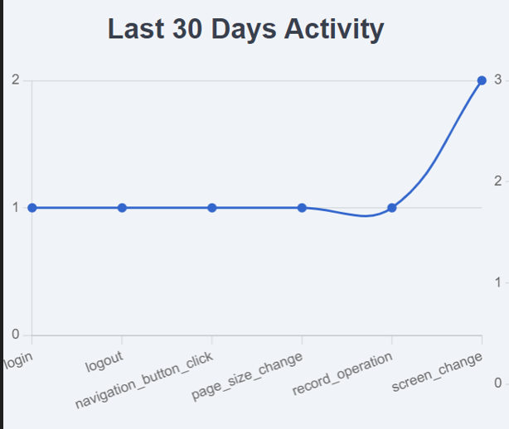
Last 30 Day Activity

Slide 11
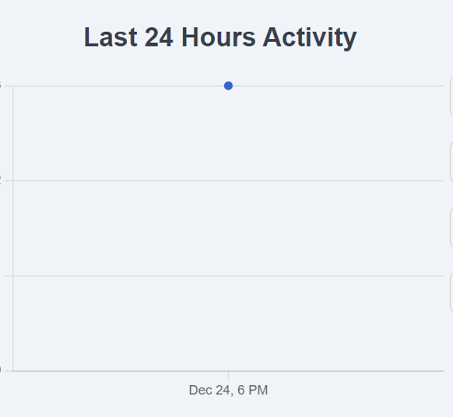
Last 24 Hours Activity

Slide 12
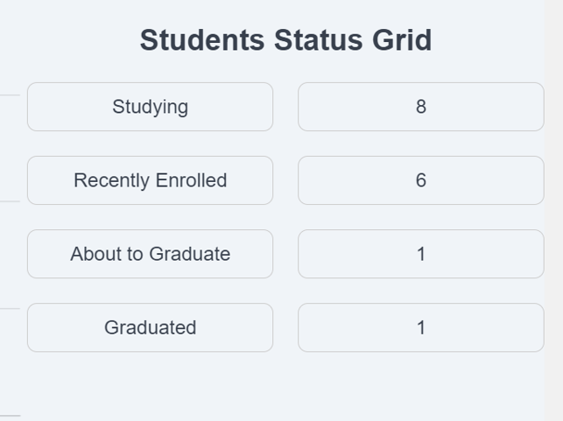
Student Status Grid

Slide 13
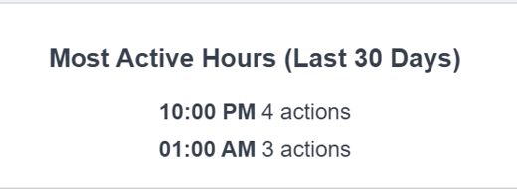
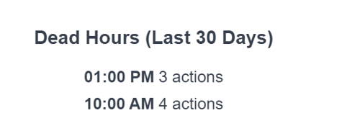
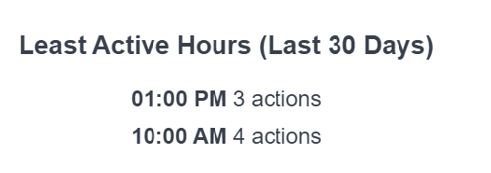
Active Hours

Slide 14
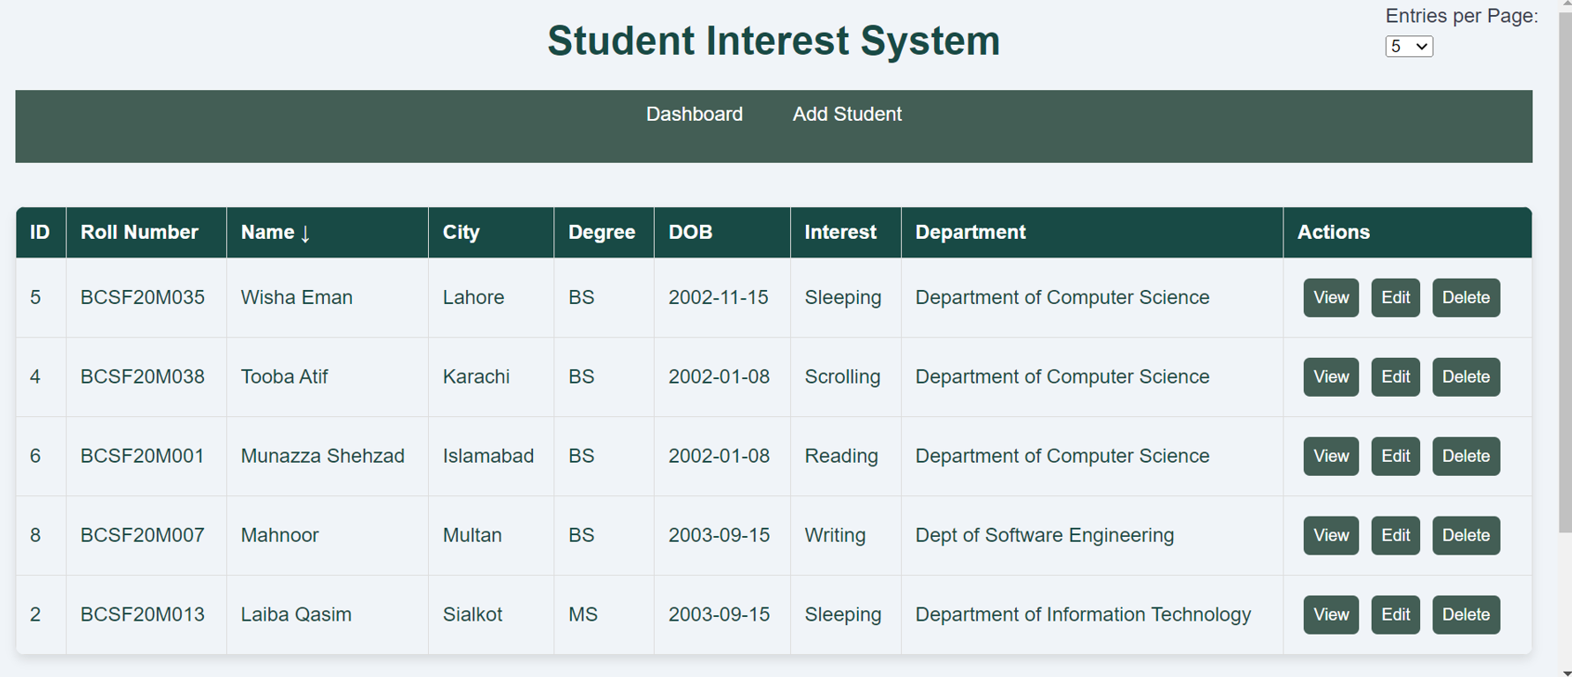
Student records

Slide 15
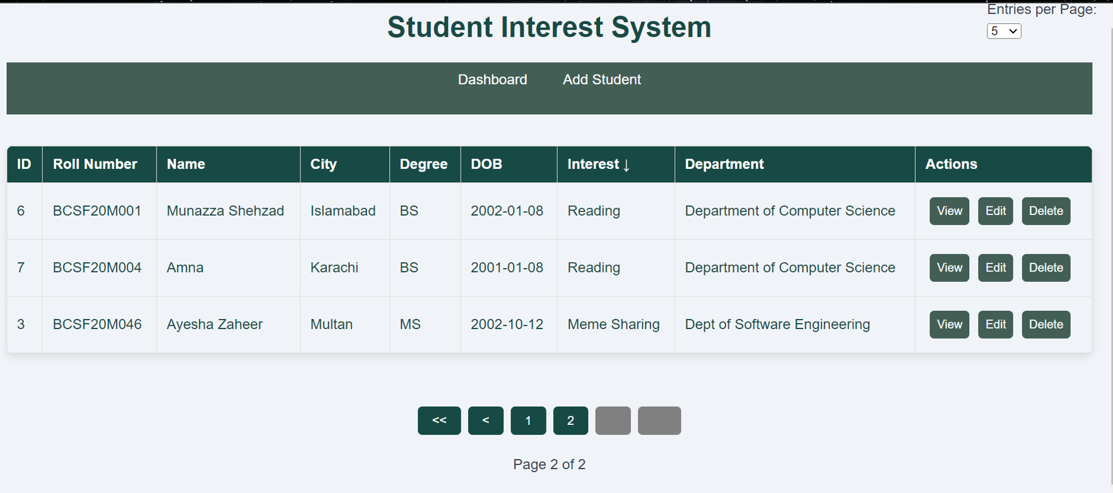
Pagination and Sorting

Slide 16
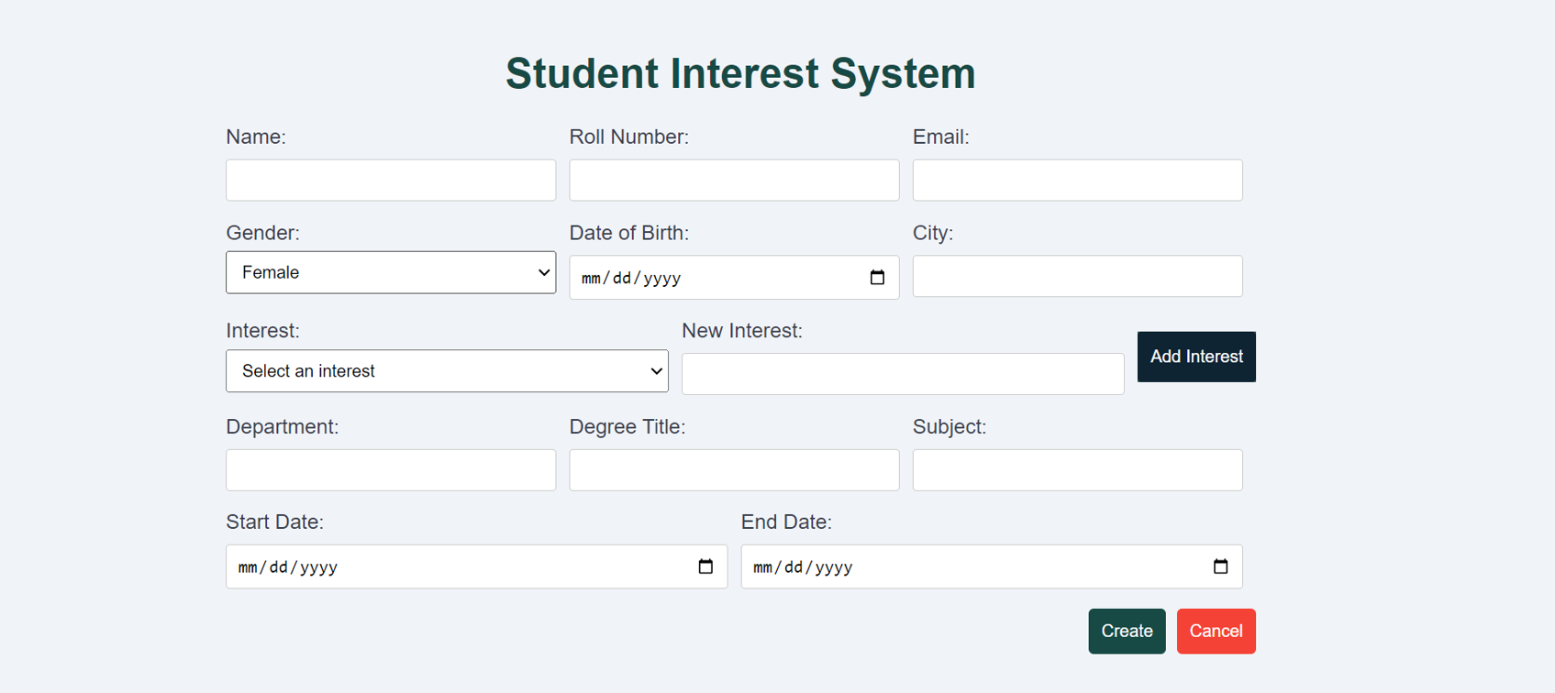
Add Student

Slide 17
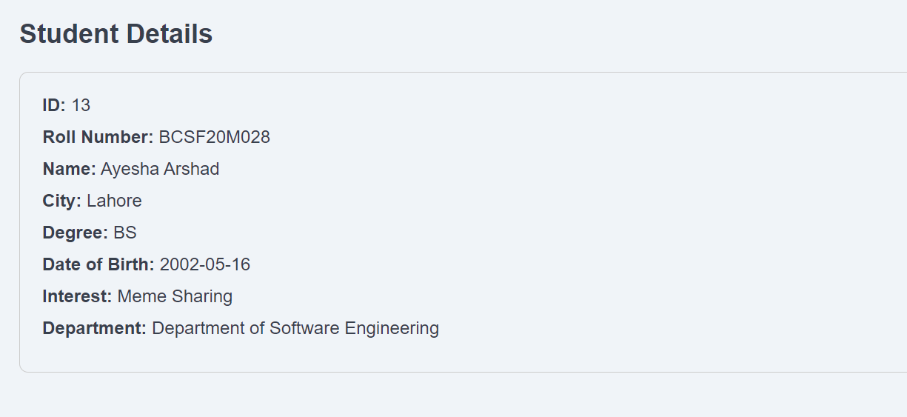
Student Details

Slide 18
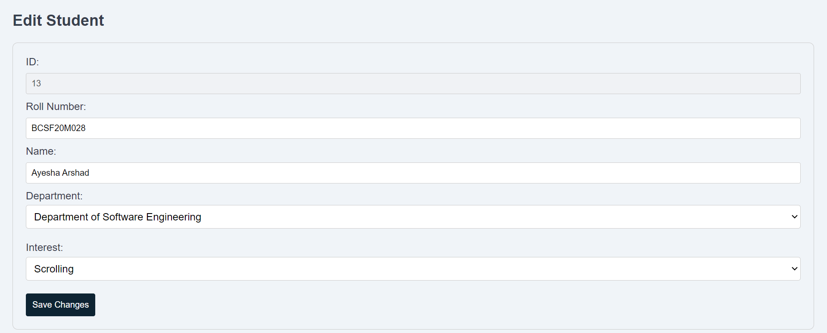
Student Update

Slide 19
Thank YOU !

